Slide 1
Java Basics 10
Guangjian Zhou
Notes:
‘

Slide 2
What is Spring Framework?
Spring Framework is a Java platform that provides comprehensive infrastructure support for developing Java applications. Spring handles the infrastructure so you can focus on your application.
Spring enables you to build applications from “plain old Java objects” (POJOs) and to apply enterprise services non-invasively to POJOs. This capability applies to the Java SE programming model and to full and partial Java EE.
Examples of how you, as an application developer, can use the Spring platform advantage:
Make a Java method execute in a database transaction without having to deal with transaction APIs.
Make a local Java method a remote procedure without having to deal with remote APIs.
Make a local Java method a management operation without having to deal with JMX APIs.
Make a local Java method a message handler without having to deal with JMS APIs.

Slide 3
What are the features of Spring Framework?
IoC container: Refers to the core container that uses the DI or IoC pattern to implicitly provide an object reference in a class during runtime. This pattern acts as an alternative to the service locator pattern. The IoC container contains assembler code that handles the configuration management of application objects. The Spring framework provides two packages, namely org.springframework.beans and org.springframework.context which helps in providing the functionality of the IoC container.
Data access framework: Allows the developers to use persistence APIs, such as JDBC and Hibernate, for storing persistence data in database. It helps in solving various problems of the developer, such as how to interact with a database connection, how to make sure that the connection is closed, how to deal with exceptions, and how to implement transaction management It also enables the developers to easily write code to access the persistence data throughout the application.
Spring MVC framework: Allows you to build Web applications based on MVC architecture. All the requests made by a user first go through the controller and are then dispatched to different views, that is, to different JSP pages or Servlets. The form handling and form validating features of the Spring MVC framework can be easily integrated with all popular view technologies such as ISP, Jasper Report, FreeMarker, and Velocity.
Transaction management: Helps in handling transaction management of an application without affecting its code. This framework provides Java Transaction API (JTA) for global transactions managed by an application server and local transactions managed by using the JDBC Hibernate, Java Data Objects (JDO), or other data access APIs. It enables the developer to model a wide range of transactions on the basis of Spring’s declarative and programmatic transaction management.
Spring Web Service: Generates Web service endpoints and definitions based on Java classes, but it is difficult to manage them in an application. To solve this problem, Spring Web Service provides layered-based approaches that are separately managed by Extensible Markup Language (XML) parsing (the technique of reading and manipulating XML). Spring provides effective mapping for transmitting incoming XML message request to an object and the developer to easily distribute XML message (object) between two machines.
JDBC abstraction layer: Helps the users in handling errors in an easy and efficient manner. The JDBC programming code can be reduced when this abstraction layer is implemented in a Web application. This layer handles exceptions such as DriverNotFound. All SQLExceptions are translated into the DataAccessException class. Spring’s data access exception is not JDBC specific and hence Data Access Objects (DAO) are not bound to JDBC only.
Spring TestContext framework: Provides facilities of unit and integration testing for the Spring applications. Moreover, the Spring TestContext framework provides specific integration testing functionalities such as context management and caching DI of test fixtures, and transactional test management with default rollback semantics.

Slide 4
What do you mean by IoC (Inversion of Control) Container?
Refers to the core container that uses the DI or IoC pattern to implicitly provide an object reference in a class during runtime. This pattern acts as an alternative to the service locator pattern. The IoC container contains assembler code that handles the configuration management of application objects. The Spring framework provides two packages, namely org.springframework.beans and org.springframework.context which helps in providing the functionality of the IoC container.
The IoC principle helps in designing loosely coupled classes which make them testable, maintainable and extensible.

Slide 5
What do you understand by Dependency Injection?
In object-oriented programming (OOP) software design, dependency injection (DI) is the process of supplying a resource that a given piece of code requires. The required resource, which is often a component of the application itself, is called a dependency.
When a software component depends upon other resources to complete its intended purpose, it needs to know which resources it needs to communicate with, where to locate them and how to communicate with them.
One way of structuring the code is to map the location of each required resource. Another way is to use dependency injections and have an external piece of code assume the responsibility of locating the resources. Typically, the external piece of code is implemented by using a framework, such as Spring for Java applications.

Slide 6
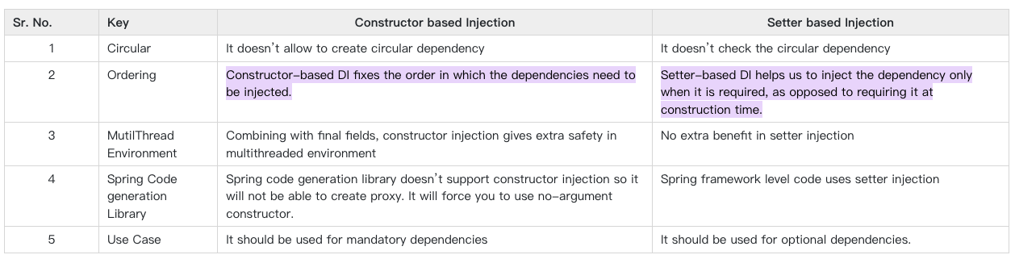
Explain the difference between constructor and setter injection?

Slide 7
What are Spring Beans?
The objects that form the backbone of your application and that are managed by the Spring IoC container are called beans. A bean is an object that is instantiated, assembled, and otherwise managed by a Spring IoC container. These beans are created with the configuration metadata that you supply to the container. For example, in the form of XML <bean/> definitions which you have already seen in the previous chapters.

Slide 8
How is the configuration meta data provided to the spring container?
Spring supports three ways to provide configuration metadata to Spring Container:
XML based configuration: We can specify configuration data in an XML file.
Annotation-based configuration: We can use Annotations to specify configuration. This was introduced in Spring 2.5.
Java-based configuration: This is introduced from Spring 3.0. We can embed annotations like @Bean, @Import, @Configuration in Java code to specify configuration metadata.

Slide 9
What are the bean scopes available in Spring?
There are five types of spring bean scopes:
singleton - only one instance of the spring bean will be created for the spring container. This is the default spring bean scope. While using this scope, make sure bean doesn’t have shared instance variables otherwise it might lead to data inconsistency issues.
prototype – A new instance will be created every time the bean is requested from the spring container.
request – This is same as prototype scope, however it’s meant to be used for web applications. A new instance of the bean will be created for each HTTP request.
session – A new bean will be created for each HTTP session by the container.
global-session – This is used to create global session beans for Portlet applications.

Slide 10
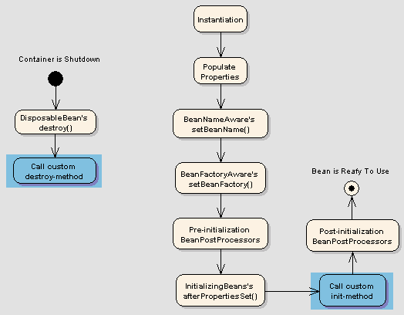
Explain Bean life cycle in Spring Bean Factory Container.

Slide 11
What do you understand by Bean Wiring.
Bean wiring is the process of combining beans with Spring container. The required beans are to be informed to the container and how the container should use dependency injection to tie them together, at the time of wiring the beans.

Slide 12
What is autowiring and name the different modes of it?
Autowiring feature of spring framework enables you to inject the object dependency implicitly. It internally uses setter or constructor injection.
Autowiring can't be used to inject primitive and string values. It works with reference only.
no
This option is default for spring framework and it means that autowiring is OFF. You have to explicitly set the dependencies using <property> tags in bean definitions.
byName
This option enables the dependency injection based on bean names. When autowiring a property in a bean, the property name is used for searching a matching bean definition in the configuration file. If such a bean is found, it is injected into the property. If no such bean is found, an error is raised.
byType
This option enables the dependency injection based on bean types. When autowiring a property in bean, the property’s class type is used for searching a matching bean definition in the configuration file. If such a bean is found, it is injected into the property. If no such bean is found, an error is raised.
constructor
Autowiring by constructor is similar to byType, but applies to constructor arguments. In autowire enabled bean, it will look for class type of constructor arguments, and then do a autowire bytype on all constructor arguments. Please note that if there isn’t exactly one bean of the constructor argument type in the container, a fatal error is raised.

Slide 13
What are the limitations of autowiring?
Explicit dependencies in constructor-argument and property settings always override autowiring. You cannot autowire simple properties such as primitives, Strings, and Classes.
Overriding possibilities: We can define dependencies using property or constructor-args tag which will always override autowiring.
Primitive data type: We have to define primitive data types String or Integer using property or constructor-args tag. You cannot autowire these tags.
Confusing Nature: If you have lot of dependency in a program, then it’s hard to find using autowire attribute of bean.

